Slide 1
Influence of Weather
Chaolun Zheng

Slide 2
Temperature data:
There is no raining day between 10-29-2019 to 11-12-2019. Therefore, we mainly investigate the influences of wind and temperature on the behaviors.
Since the traffic behavior of students appeal us more, weekday was chosen instead of weekend. To minimize the influences of class schedules and weekly events (e.g. farmer market), same weekday were chosen.

Slide 3
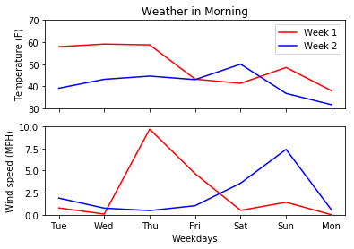
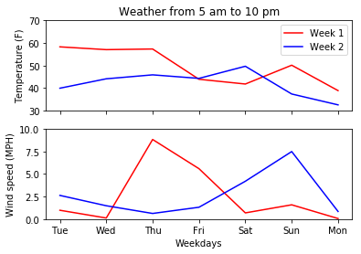
Weather data:
Generally speaking, student would decided their traffic methods based on the temperature in the morning. Therefore, we calculated the average temperature and wind_speed from 5am to 10 am and 5am to 10pm separately. However, the temperature trends between different day are similar.

Slide 4
Temperature data:
Based on the temperature data, we decided to choose Wednesday (i.e. Oct 30 and Nov. 6) as our study cases, which has large temperature difference, but similar wind speed.
For the wind speed study Wednesday and Thursday in first week were chosen, since it share similar temperature but large difference in wind speed.

Slide 5
Data Preparation
There are three locations that have multiple sensors. To represent the traffic data in this location, for any certain time, I sum up all the data for sensors in this location. I then divide the summed number by two to eliminate the effect of double counting.
Among the five sensor locations, four of them are at the campus exits (i.e. north, south, west, and east exits). Therefore, I sum up the data at that time to represents the traffic enter/leaving the campus. The sensors at Stadium Drive & Regents Drive is at the center of campus. Therefore, I treat it separately to represents the traffic condition in campus.

Slide 6
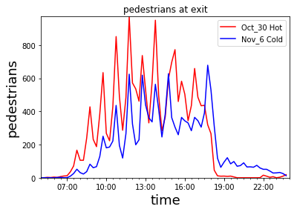
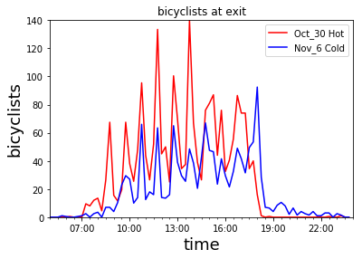
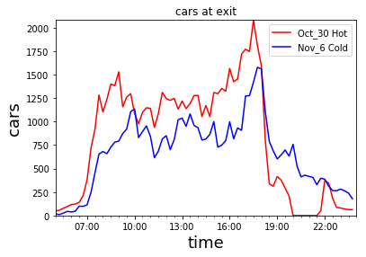
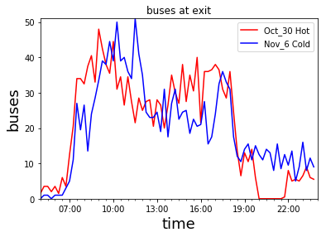
Temperature on pedestrian and bike:

Slide 7
Influence of temperature:
It was found that the number of pedestrians, bike and car entering/leaving the campus were all reduced in cold temperature. It implies that students may prefer to take shuttles to campus in cold weather, or the student attendance is reduced. The influences of temperature on bus is minor, which may result from the fixed bus schedule.
It should be noted that the reduce of number in early hour is more significant, especially for pedestrians and bike. For example, while the acuminated number of pedestrians on Oct. 30 is about 1.5 times of that on Nov. 6, the number of accumulated pedestrians before 9 am on Oct. 30 is about 3.5 times more than that on Nov. 6. The influences on bicyclist is even more significant. While the acuminated number of on Oct. 30 is about 2 times of that on Nov. 6, the number of accumulated pedestrians before 9 am on Oct. 30 is about 5.5 times more than that on Nov. 6.
It implies that student trend to sleep late or quite morning exercise in cold weather. lol

Slide 8
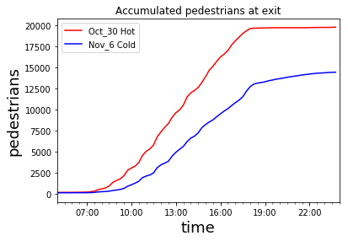
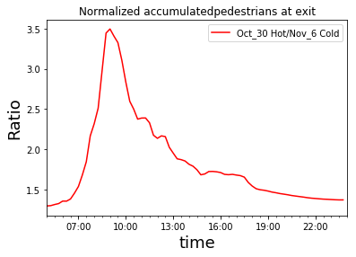
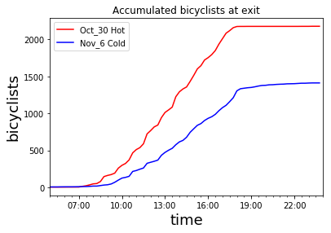
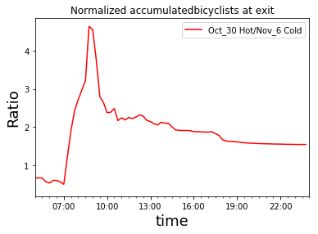

Slide 9
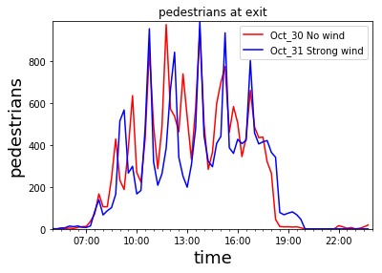
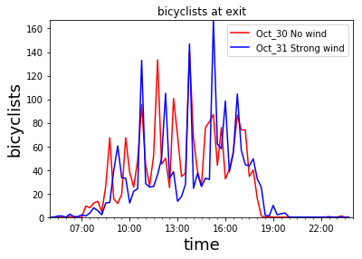
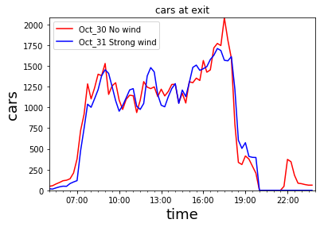
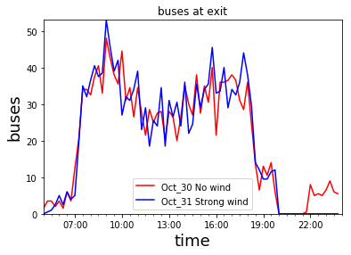
Influence of wind:

Slide 10
Summary:
No significant differences were observed

Slide 11
First Predictive Model.
Model method: MLPRegressor
Feature input : (1) time in a day[0.0..23.75]; (2) weekday [1..7]; (3) Football game start time, -1 (if not game on that day); (4) Football game end time, -1 (if not game on that day); (5) temperature; (6) is_weekend [-1,1]; (6) is_gameday [-1,1]; (7) class_peak (whether the hour has class schedule peaks) [-1,1]; (8) FB_period (-1, if there is not a game day, the differences from kickoff time)

Slide 12
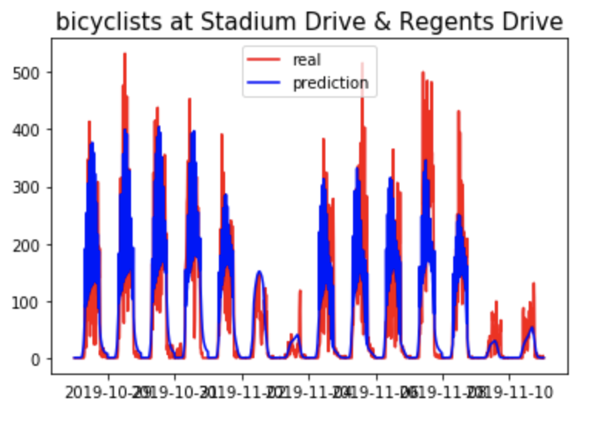
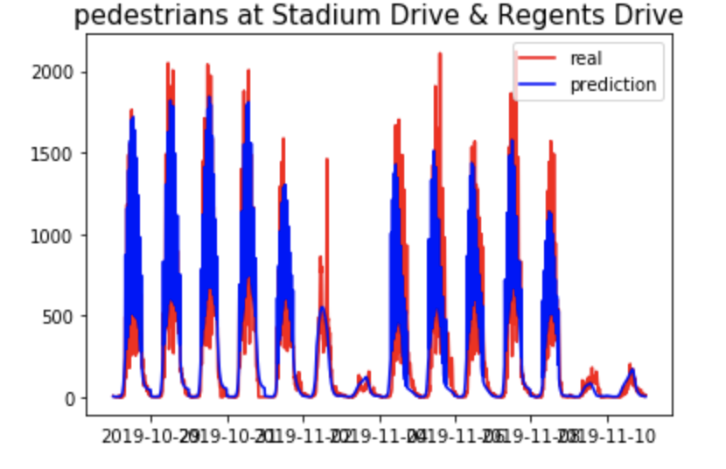
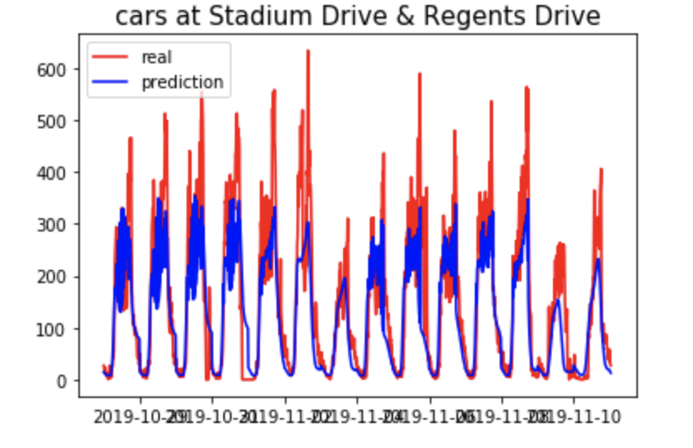
Result:

Slide 13
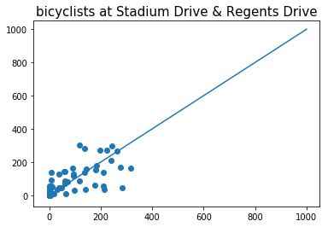
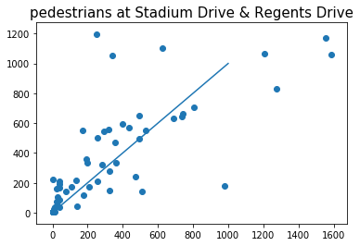
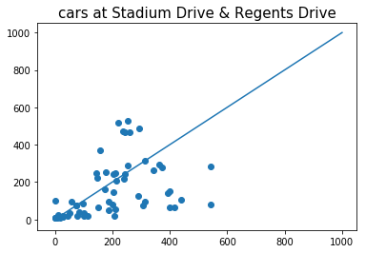
Results:
R2=0.36

Slide 14
Results
1. Our first MLPRegressor can not capture the game day behavior very well. It may results from the complex interactions before different features.

Slide 15
Second Predictive Model. Hierarchical random forest learners
Model method: (1) Decision trees learner for training and predicting the behavior on game day. (2) random forest learner for non-game day situation.
Feature input : (1) time in a day[0.0..23.75]; (2) weekday [1..7]; (3) Football game start time, -1 (if not game on that day); (4) Football game end time, -1 (if not game on that day); (5) temperature; (6) is_weekend [-1,1]; (6) is_gameday [-1,1]; (7) class_peak (whether the hour has class schedule peaks) [-1,1].
Three different sub-models were used to build this model: (1) a random forest learner to evaluate the influences of hours on traffic pattern without course schedule. (2) a random forest learner to evaluate the combined influences of course schedule, temperature, and basketball game. (3) a decision trees learner to evaluate the behavior in game day.

Slide 16
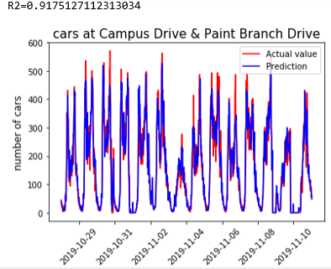
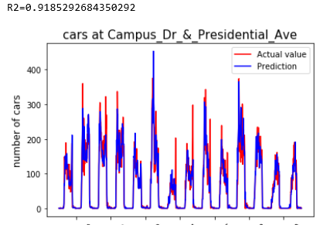
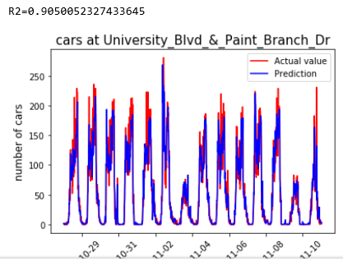
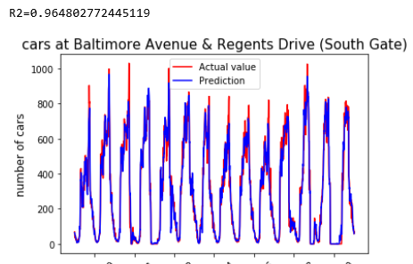
Performances:
Using 50% random data for training:
It produce good
prediction, especially for
Car at all location.

Slide 17
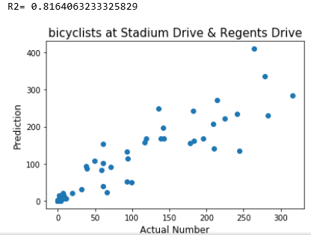
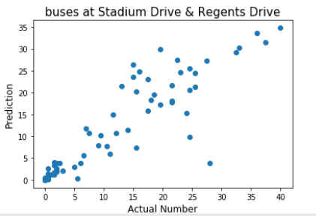
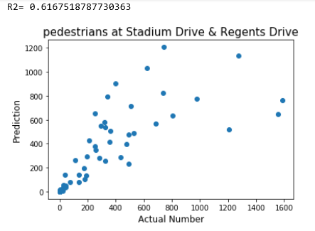
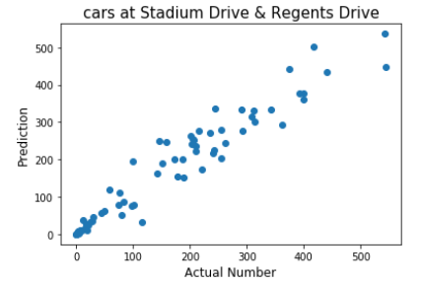
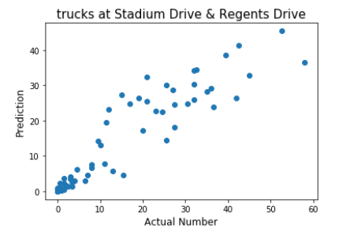
Result:

